Slide 1
Performance Related Changes and their User Impact
Eric Schurman
Principal Development Lead
Bing
Jake Brutlag
Decision Support Engineering Analyst
Google

Slide 2
Experiments
Server Delays (Microsoft and Google)
Page Weight Increases
Progressive Rendering

Slide 3
Server-side Delays Experiment
Goal
Determine impact of server delays
Methodology
Delay before sending results
Different experiments with different delays
Small number of users
Monitor negative impact

Slide 4
Server Delays Experiment: Results
- Means no statistically significant change
Strong negative impacts
Roughly linear changes with increasing delay
Time to Click changed by roughly double the delay

Slide 5
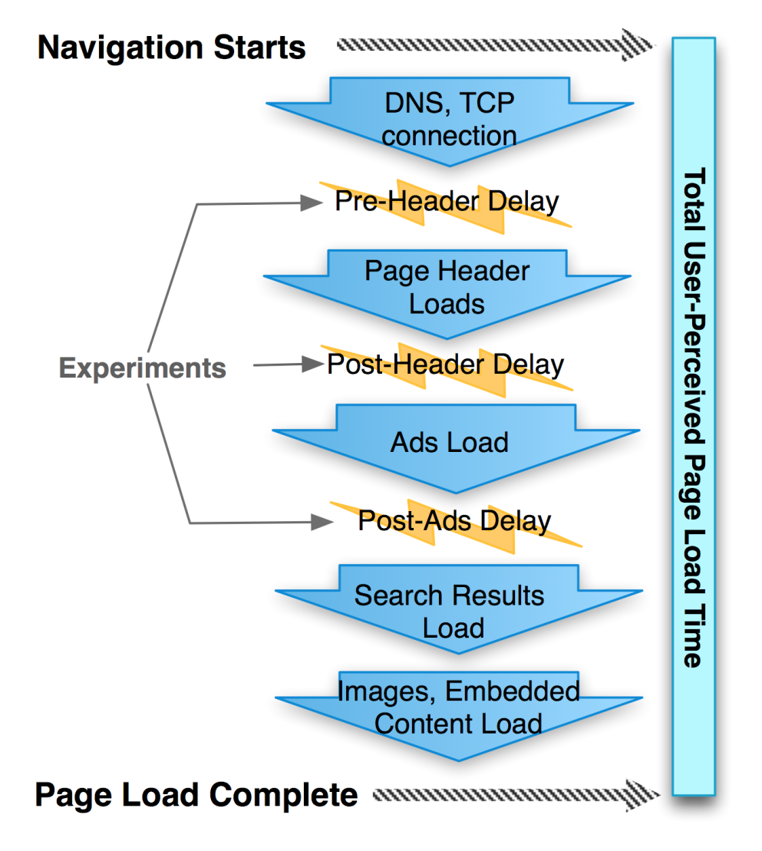
Google Web Search Delay Experiments
A series of experiments on a small % search traffic to measure the impact of latency on user behavior
Randomly assign users to the experiment and control groups (A/B testing)
Server-side delay:
Emulates additional server processing time
May be partially masked by network connection
Varied type of delay, magnitude (in ms), and duration (number of weeks)

Slide 6
Search Traffic Impact
Type of Delay | Delay (ms) | Experiment Duration (weeks) | Impact on Average Daily Searches Per User
Pre-header | 50 | 4 | Not measurable
Pre-header | 100 | 4 | -0.20%
Post-header | 200 | 6 | -0.29%
Post-header | 400 | 6 | -0.59%
Post-ads | 200 | 4 | -0.30%
Increase in abandonment heuristic = less satisfaction
Abandonment heuristic measures if a user stops interacting with search engine before they find what they are looking for
Active users (users that search more often a priori) are more sensitive

Slide 7
-0.22%
-0.36%
-0.44%
-0.74%

Slide 8
-0.08%
-0.21%

Slide 9
Page Weight Experiment
_{<html>}
_{<head>}
_{<CSS />}
_{<!--Payload-->}
_{</head>}
_{<body>}
_{<answer>...}
_{<!--Payload-->}
_{</answer>}
_{<results>}
_{<result>...}
_{<!--Payload-->}
_{</result>}
_{<result>...}
_{<!--Payload-->}
_{</result>}
_{<result>...}
_{<!--Payload-->}
_{</result>}
_{</results>}
...
_{<!--Payload-->}
_{<script />}
_{<!--Payload-->}
_{</body>}
_{</html>}
Goal
Determine impact of a heavier page.
Isolate bytes over the wire cost, not layout costs, etc.
Methodology
Use incompressible HTML comments
Vary size (from 1.05x to 5x page size) and location of payload
Experiment with payload in individual and multiple locations
US-only test – mostly good broadband

Slide 10
Page Weight Experiment: Results
Minimal impact for small payloads
Payload at top of page had stronger effect
Performance suffered slightly – would have been worse if tested in regions with poor connectivity
Click metrics impacted more than Query metrics
Largest experiment (approx 5X control page size)
Any Clicks: -0.55%
No changes to query metrics
Results only apply to one GET – not multiple

Slide 11

Progressive Rendering Experiment
Visual Header - Fast to compute
Results - Slower to compute
Goal
Determine impact sending visual header before results.
Methodology
Build page in phases
Send using HTTP 1.1 Chunked Transfer Encoding
Application design impacts

Slide 12
Progressive Rendering Experiment: Results
Metric | Change
Performance | Faster across all latency percentiles 4-18% faster to download all HTML Roughly halved time to see visible page change
Time to Click | ~9% faster
Query refinement | +2.2%
Clicks overall | +0.7%
Pagination | +2.3%
Satisfaction | +0.7%

Slide 13
Conclusion
"Speed matters" is not just lip service
Delays under half a second impact business metrics
The cost of delay increases over time and persists
Number of bytes in response is less important than what they are and when they are sent
Use progressive rendering

